Slide 1

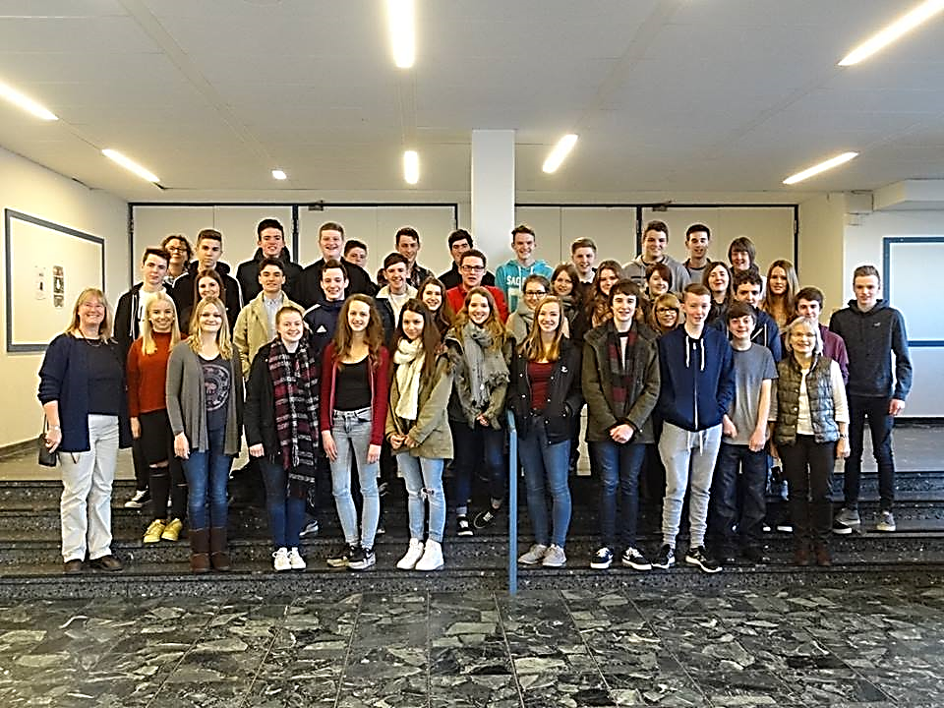
Project on the Culture of Work
St Columb’s College

Slide 2



What did we do?
26th November- 6th December
Exchange Trip- Partner families in Hannover
3 day placement
Partner School- IGS Langenhagen
School Employer Connections
Funded by UK-German Connection

Slide 3
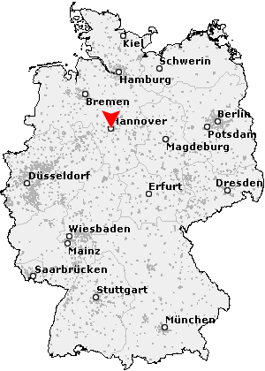
Where?
Langenhagen is a city outside Hannover.
Placements in Hannover & Langenhagen

Slide 4

School Employer Connections
Preparation before visit
Placement workshop
Industrial visit to Seagate
Organised placements in Derry
Special thanks to Mr. Crozier from School Employer Connections

Slide 5
The German Experience
Contact with German partners from June
Christmas markets
School and classes
Host families - German experience

Slide 6
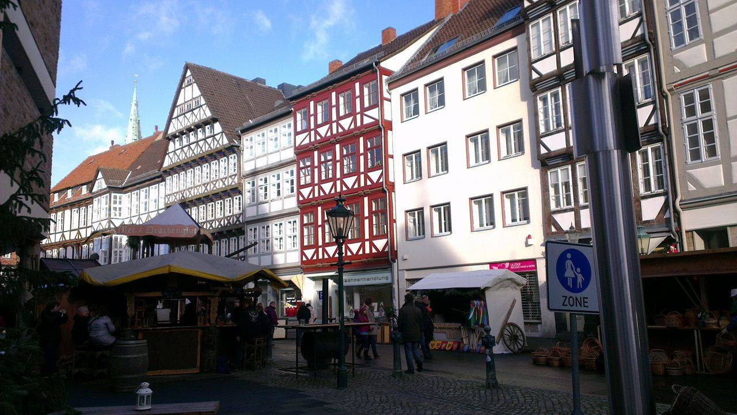
The German Experience
Experienced food and music
Language skills
Friends for life
Hannover

Slide 7
Work Experience
Placements organised based on student preference
Teaching, pharmacy, physiotherapy, solicitor, IT, engineering, journalism, police….
Unique opportunity to speak German and get an insight into workplaces

Slide 8
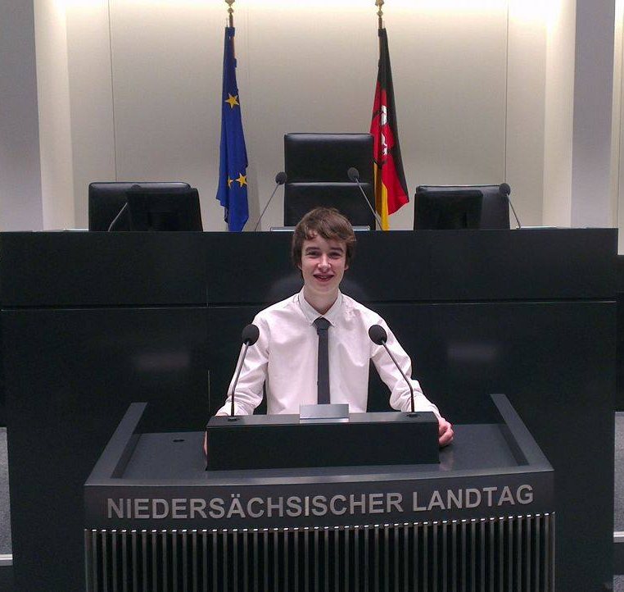
State Parliament

Slide 9
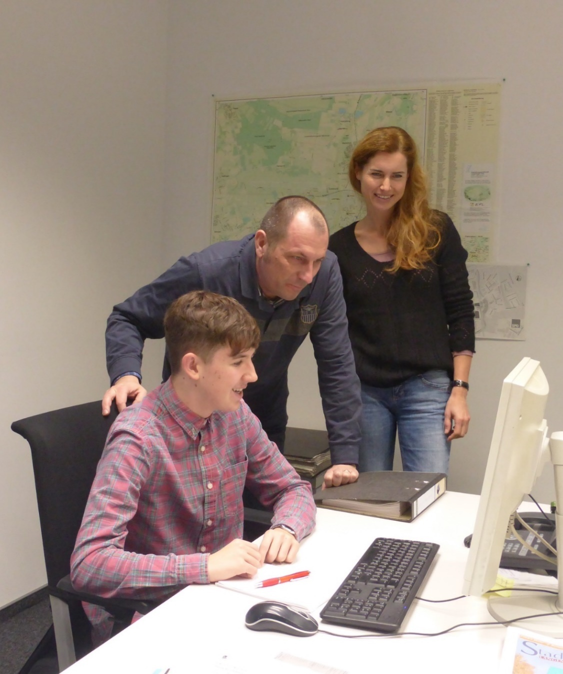
Journalism

Slide 10
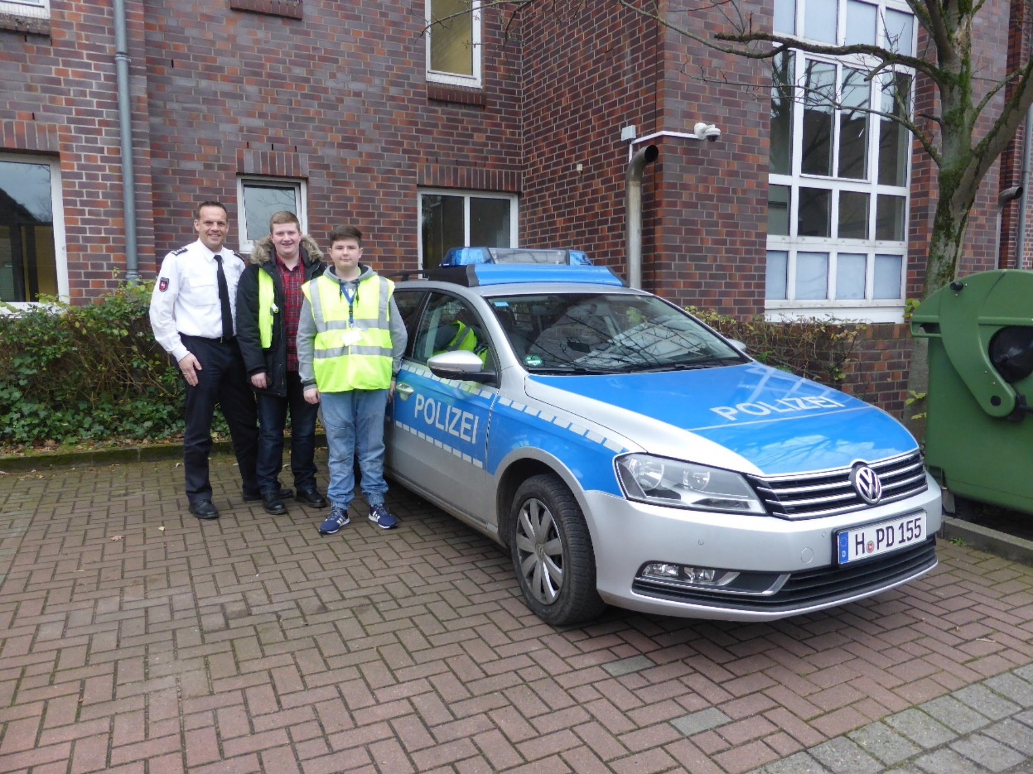
Police

Slide 11
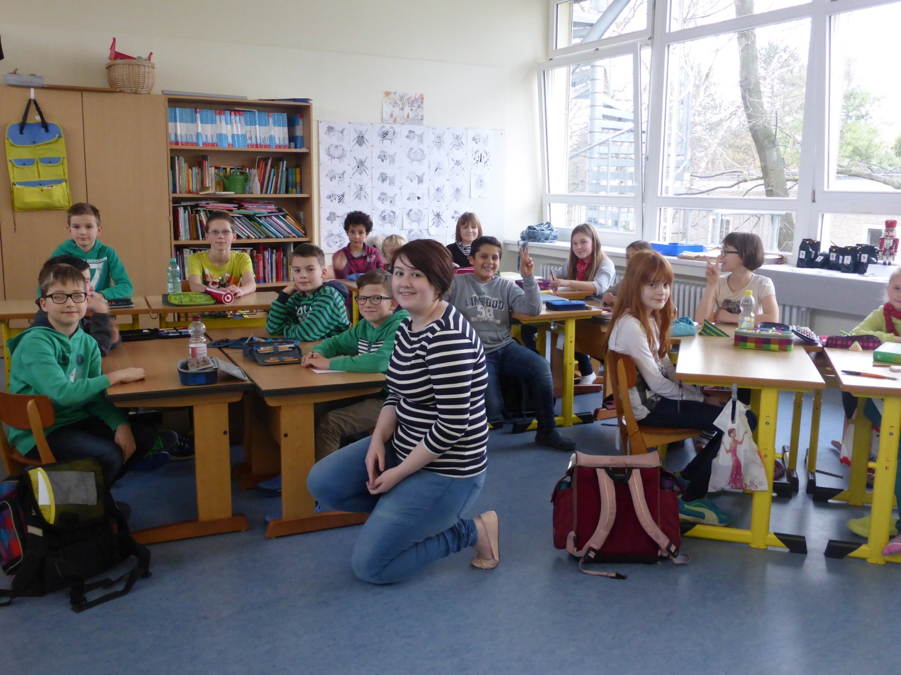
Teaching

Slide 12
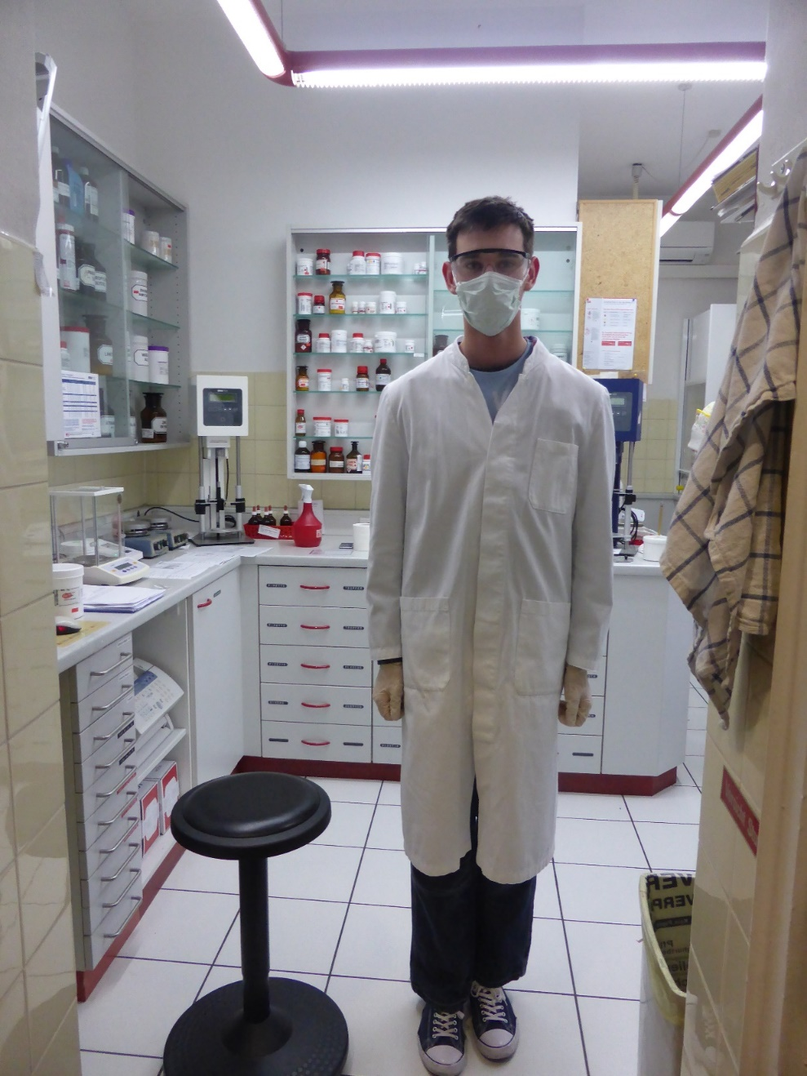
Pharmacy

Slide 13
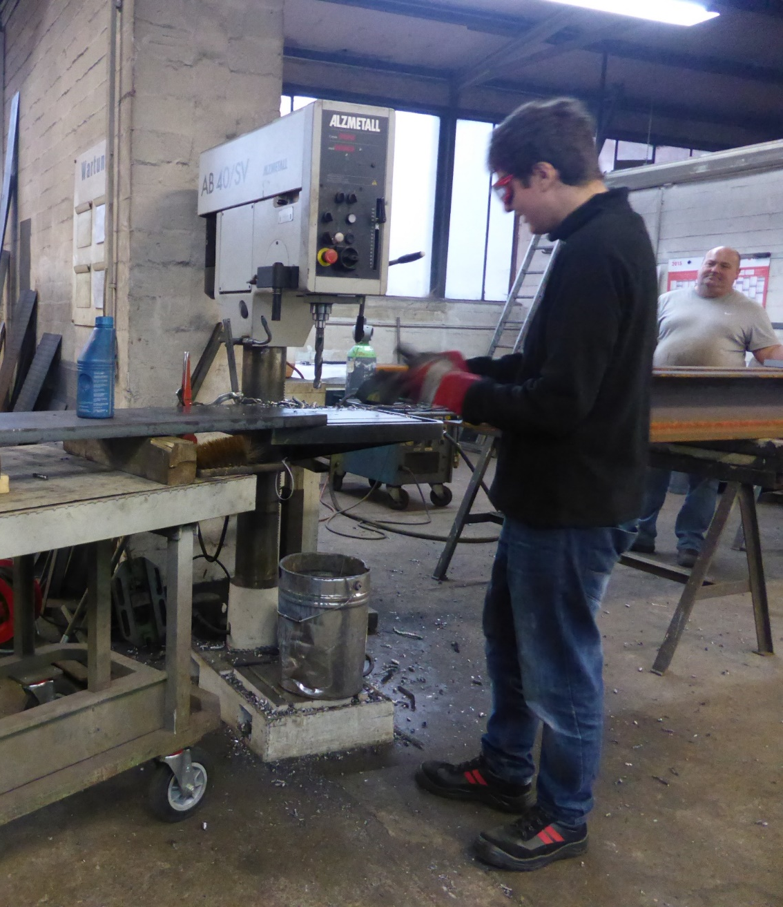
Engineering

Slide 14
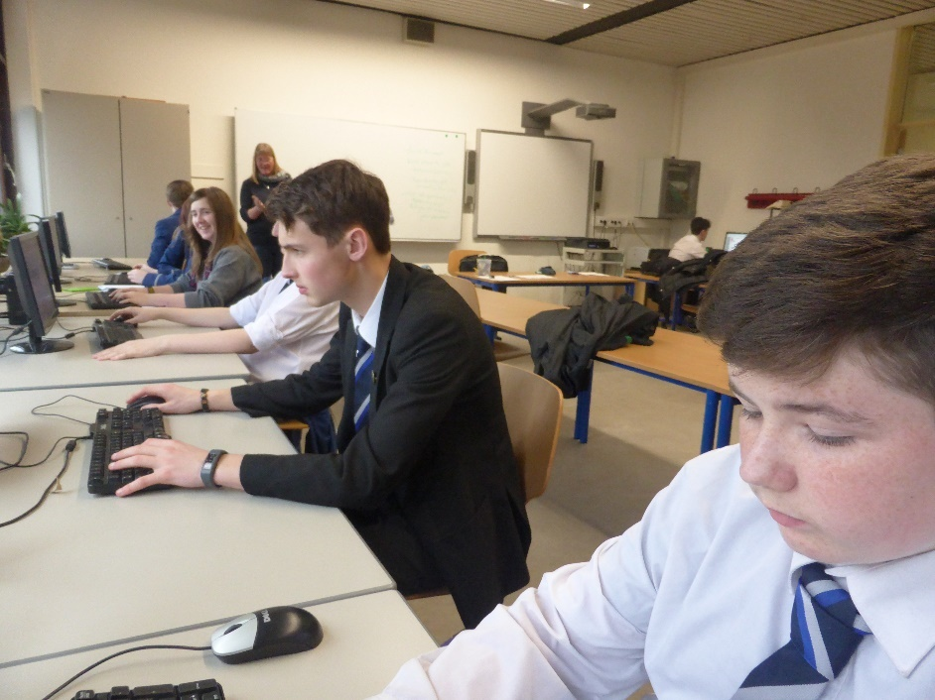
Project work in Germany
Interviews with parents of partners
Discussing opportunities available in Germany
Partner discussions about future plans
Comparison of careers education in both schools
Interviews and discussions with co-workers

Slide 15
Focus of Project Work
Focus on ‘Duale System’ or the ‘Dual System’ in which Germans both work and receive vocational training whilst remaining part time in education- they learn by doing!
Opportunities for Northern Ireland
Focus changed to different attitudes of work

Slide 16
Findings
Workers in Germany often held many positions before settling in their careers
There are many opportunities for foreigners in Germany
Large presence of family orientated businesses!

Slide 17
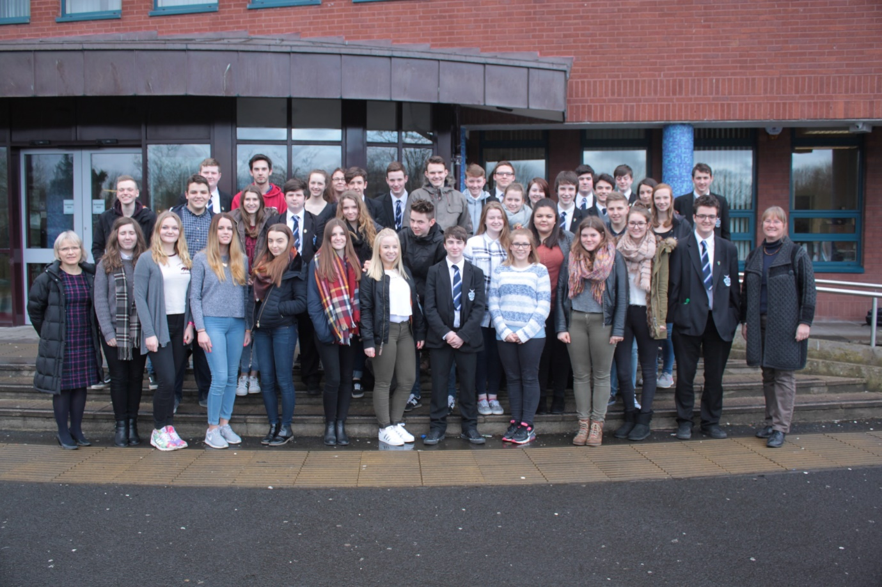
Northern Ireland
31st January-10th February
English language and experience life in Northern Ireland
Continuation of project

Slide 18
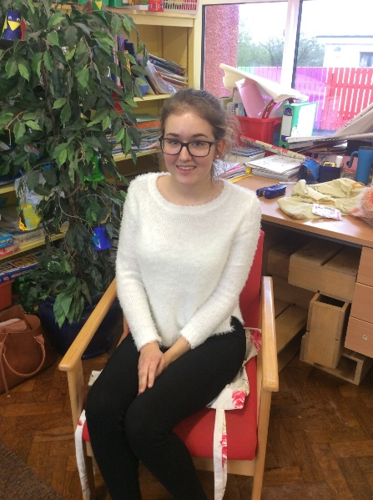
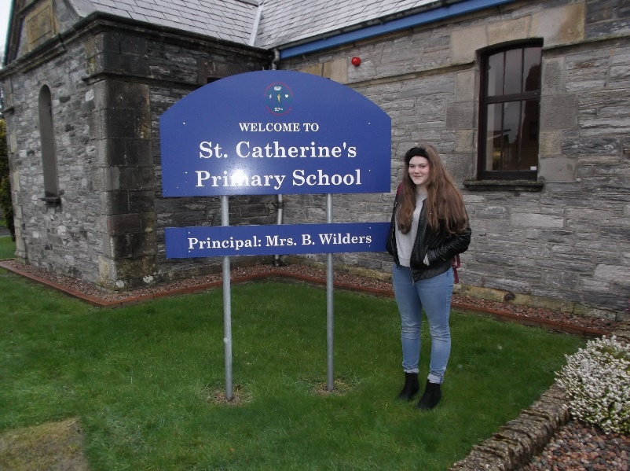
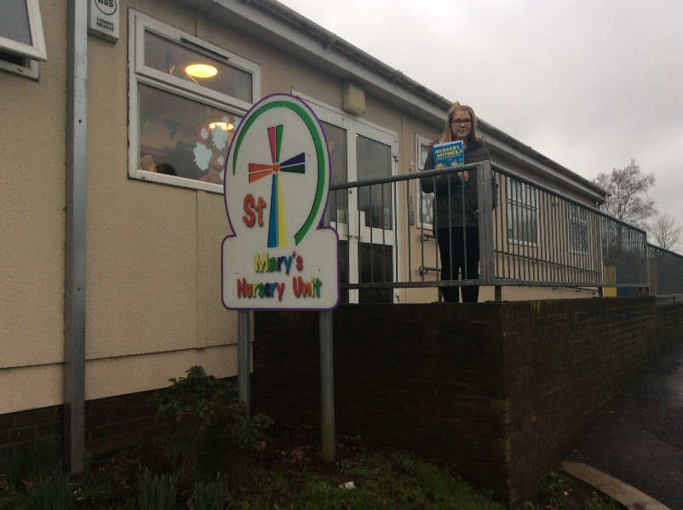
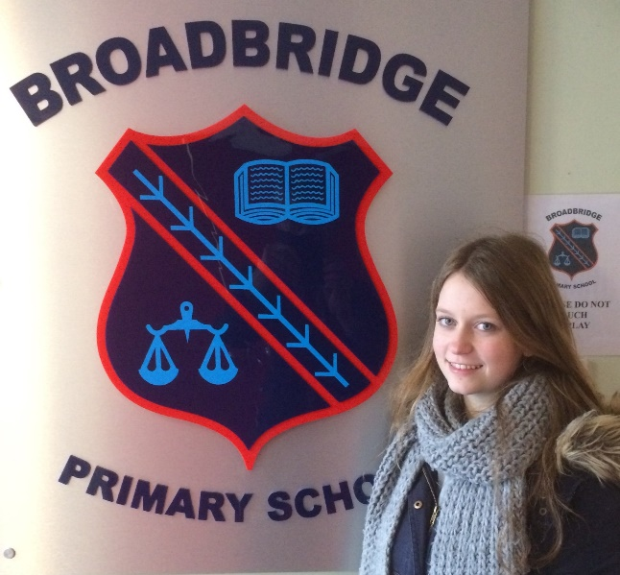

Slide 19
Culture of work
Wall displays on
Work ethic
Industrialisation
Unemployment
Labour day
Career education

Slide 20
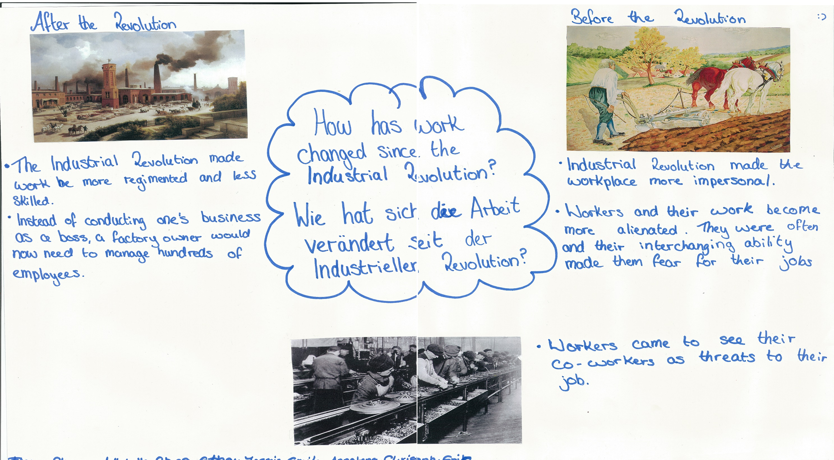

Slide 21
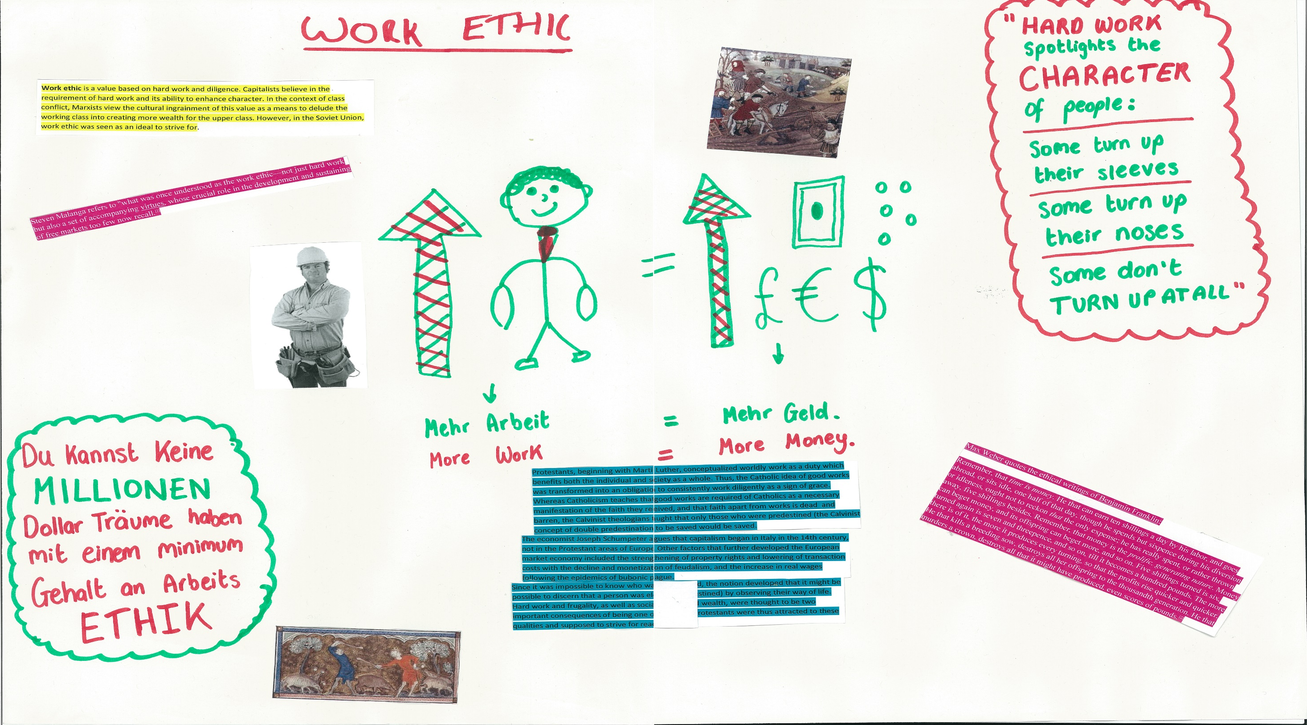

Slide 22
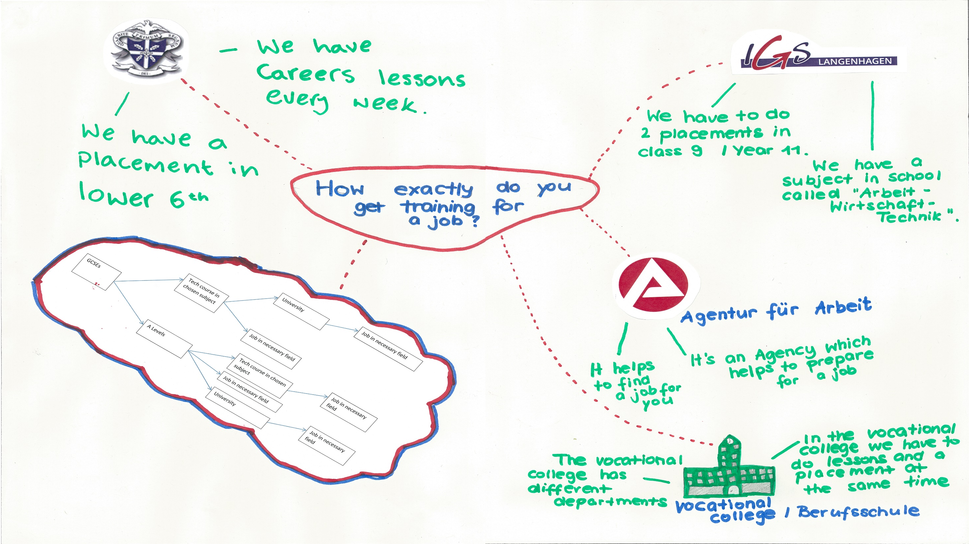

Slide 23
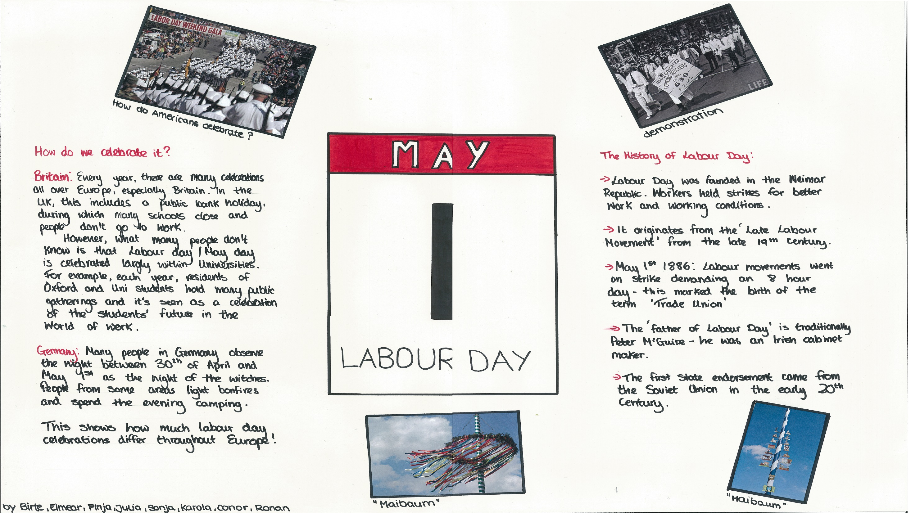

Slide 24
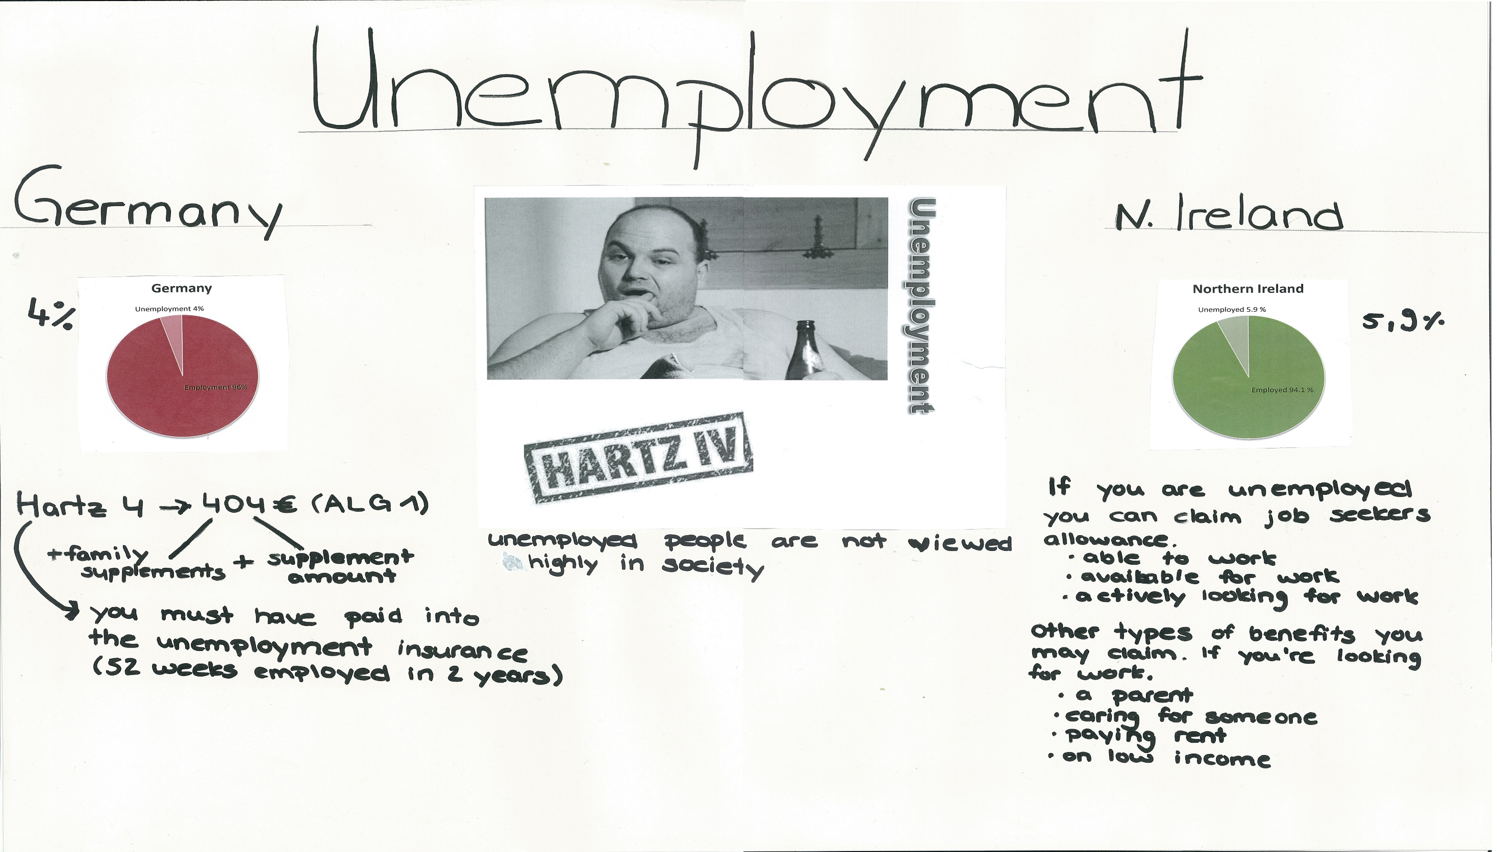

Slide 25
Findings
Different opinions on work
Different emphasis on careers education
Different opinions about unemployment

Slide 26
Languages- What do we think?
What did we get from the experience?
Improve our understanding of our own language
Improved our German
Gave us an exclusive feature for applications
Showed us the opportunities in Europe if we have languages

Slide 27
DANKESCHÖN Are there any questions?

Slide 28
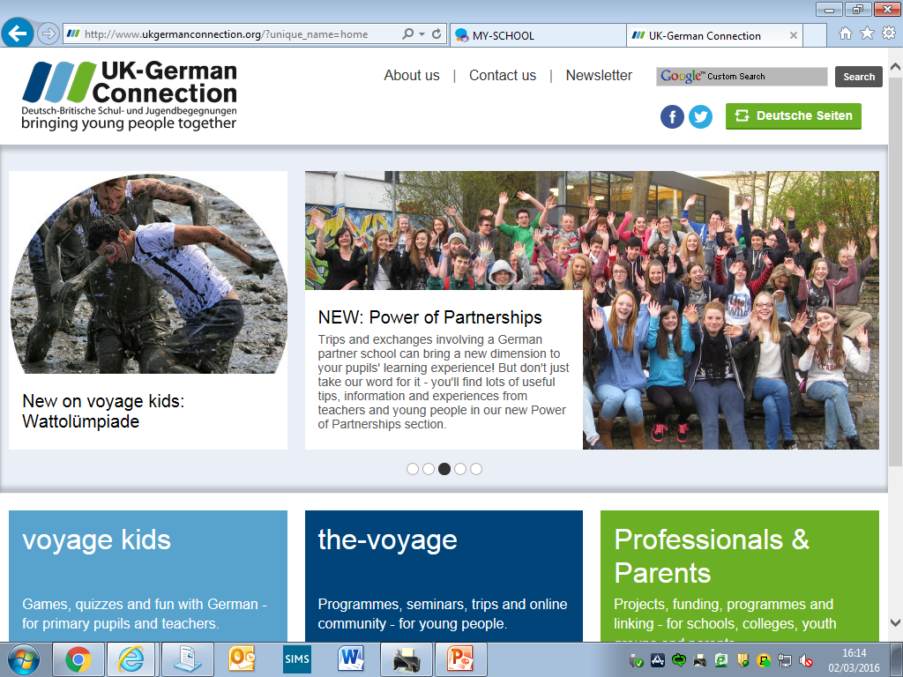

Slide 29
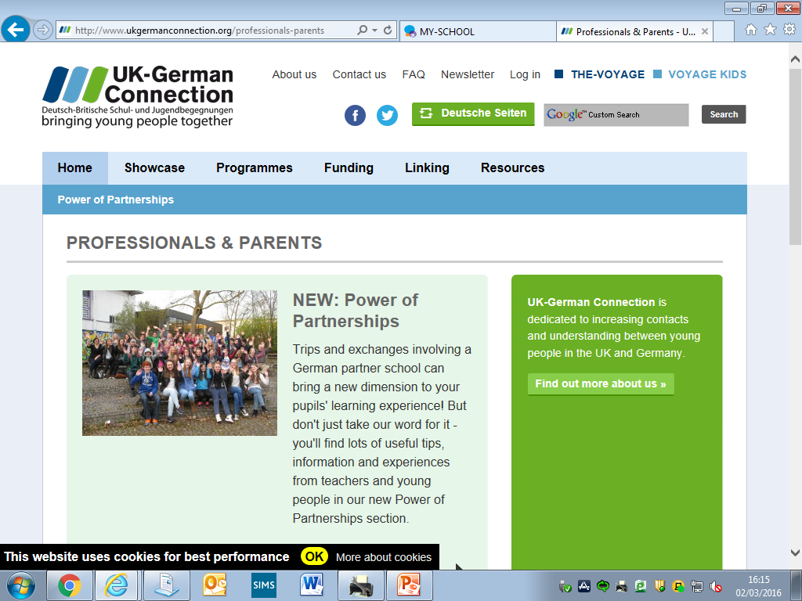

Slide 30
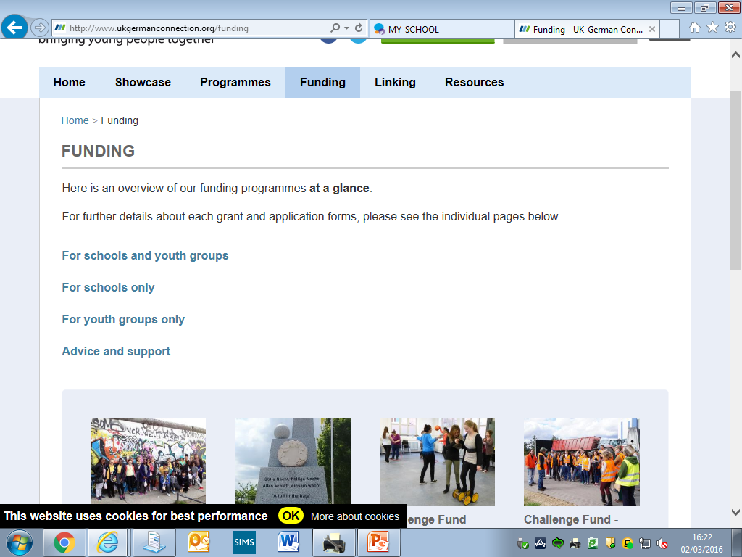

Slide 31
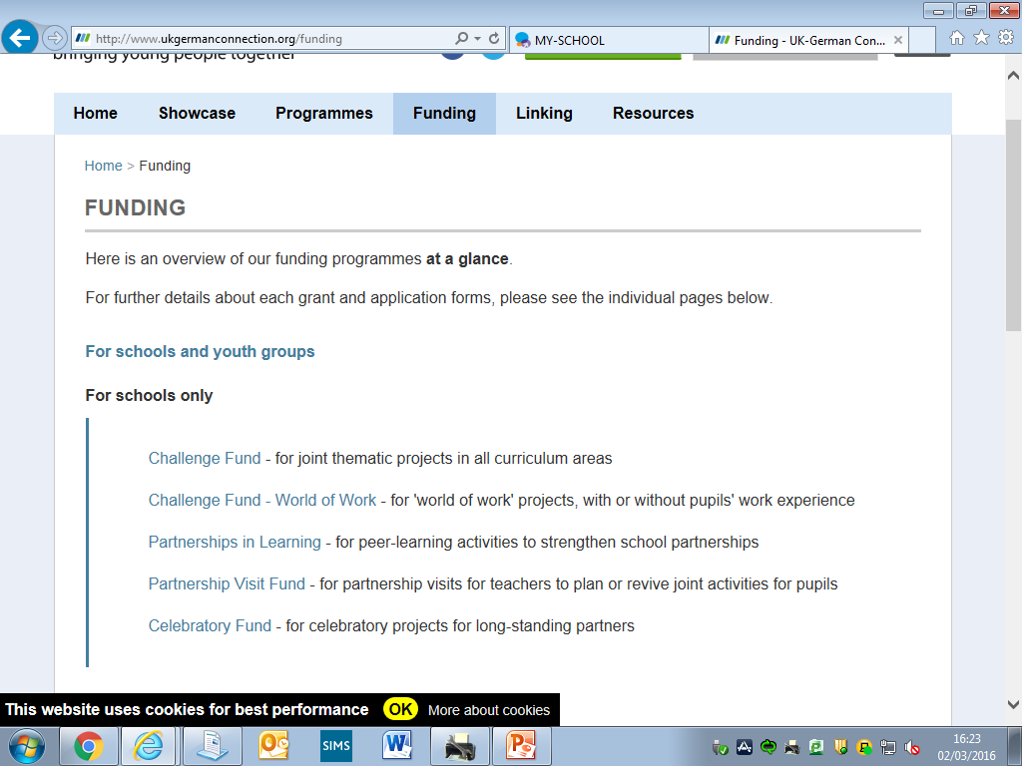

Slide 32
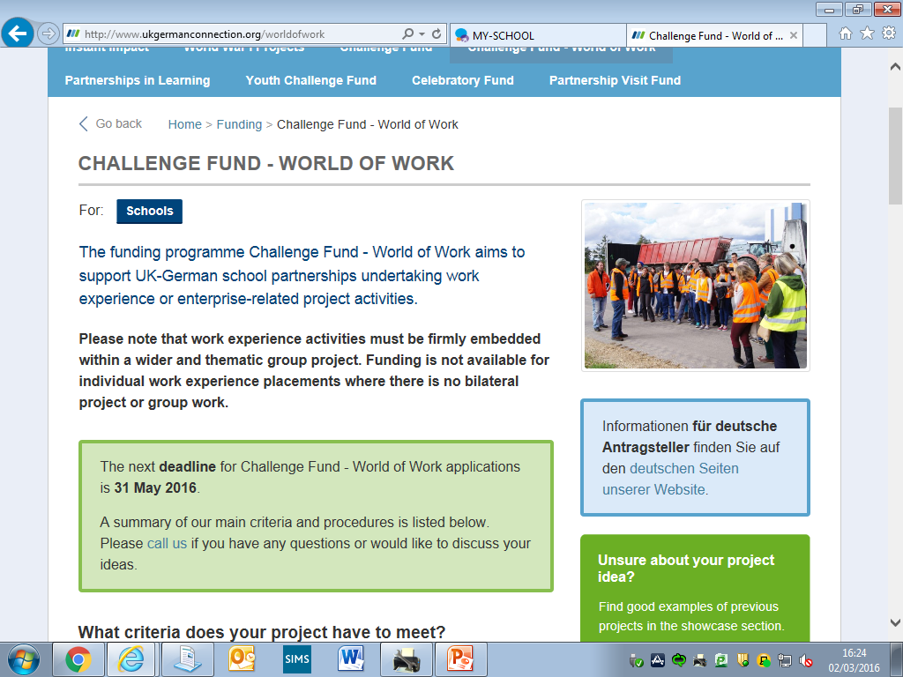

Slide 33
